Slide 1
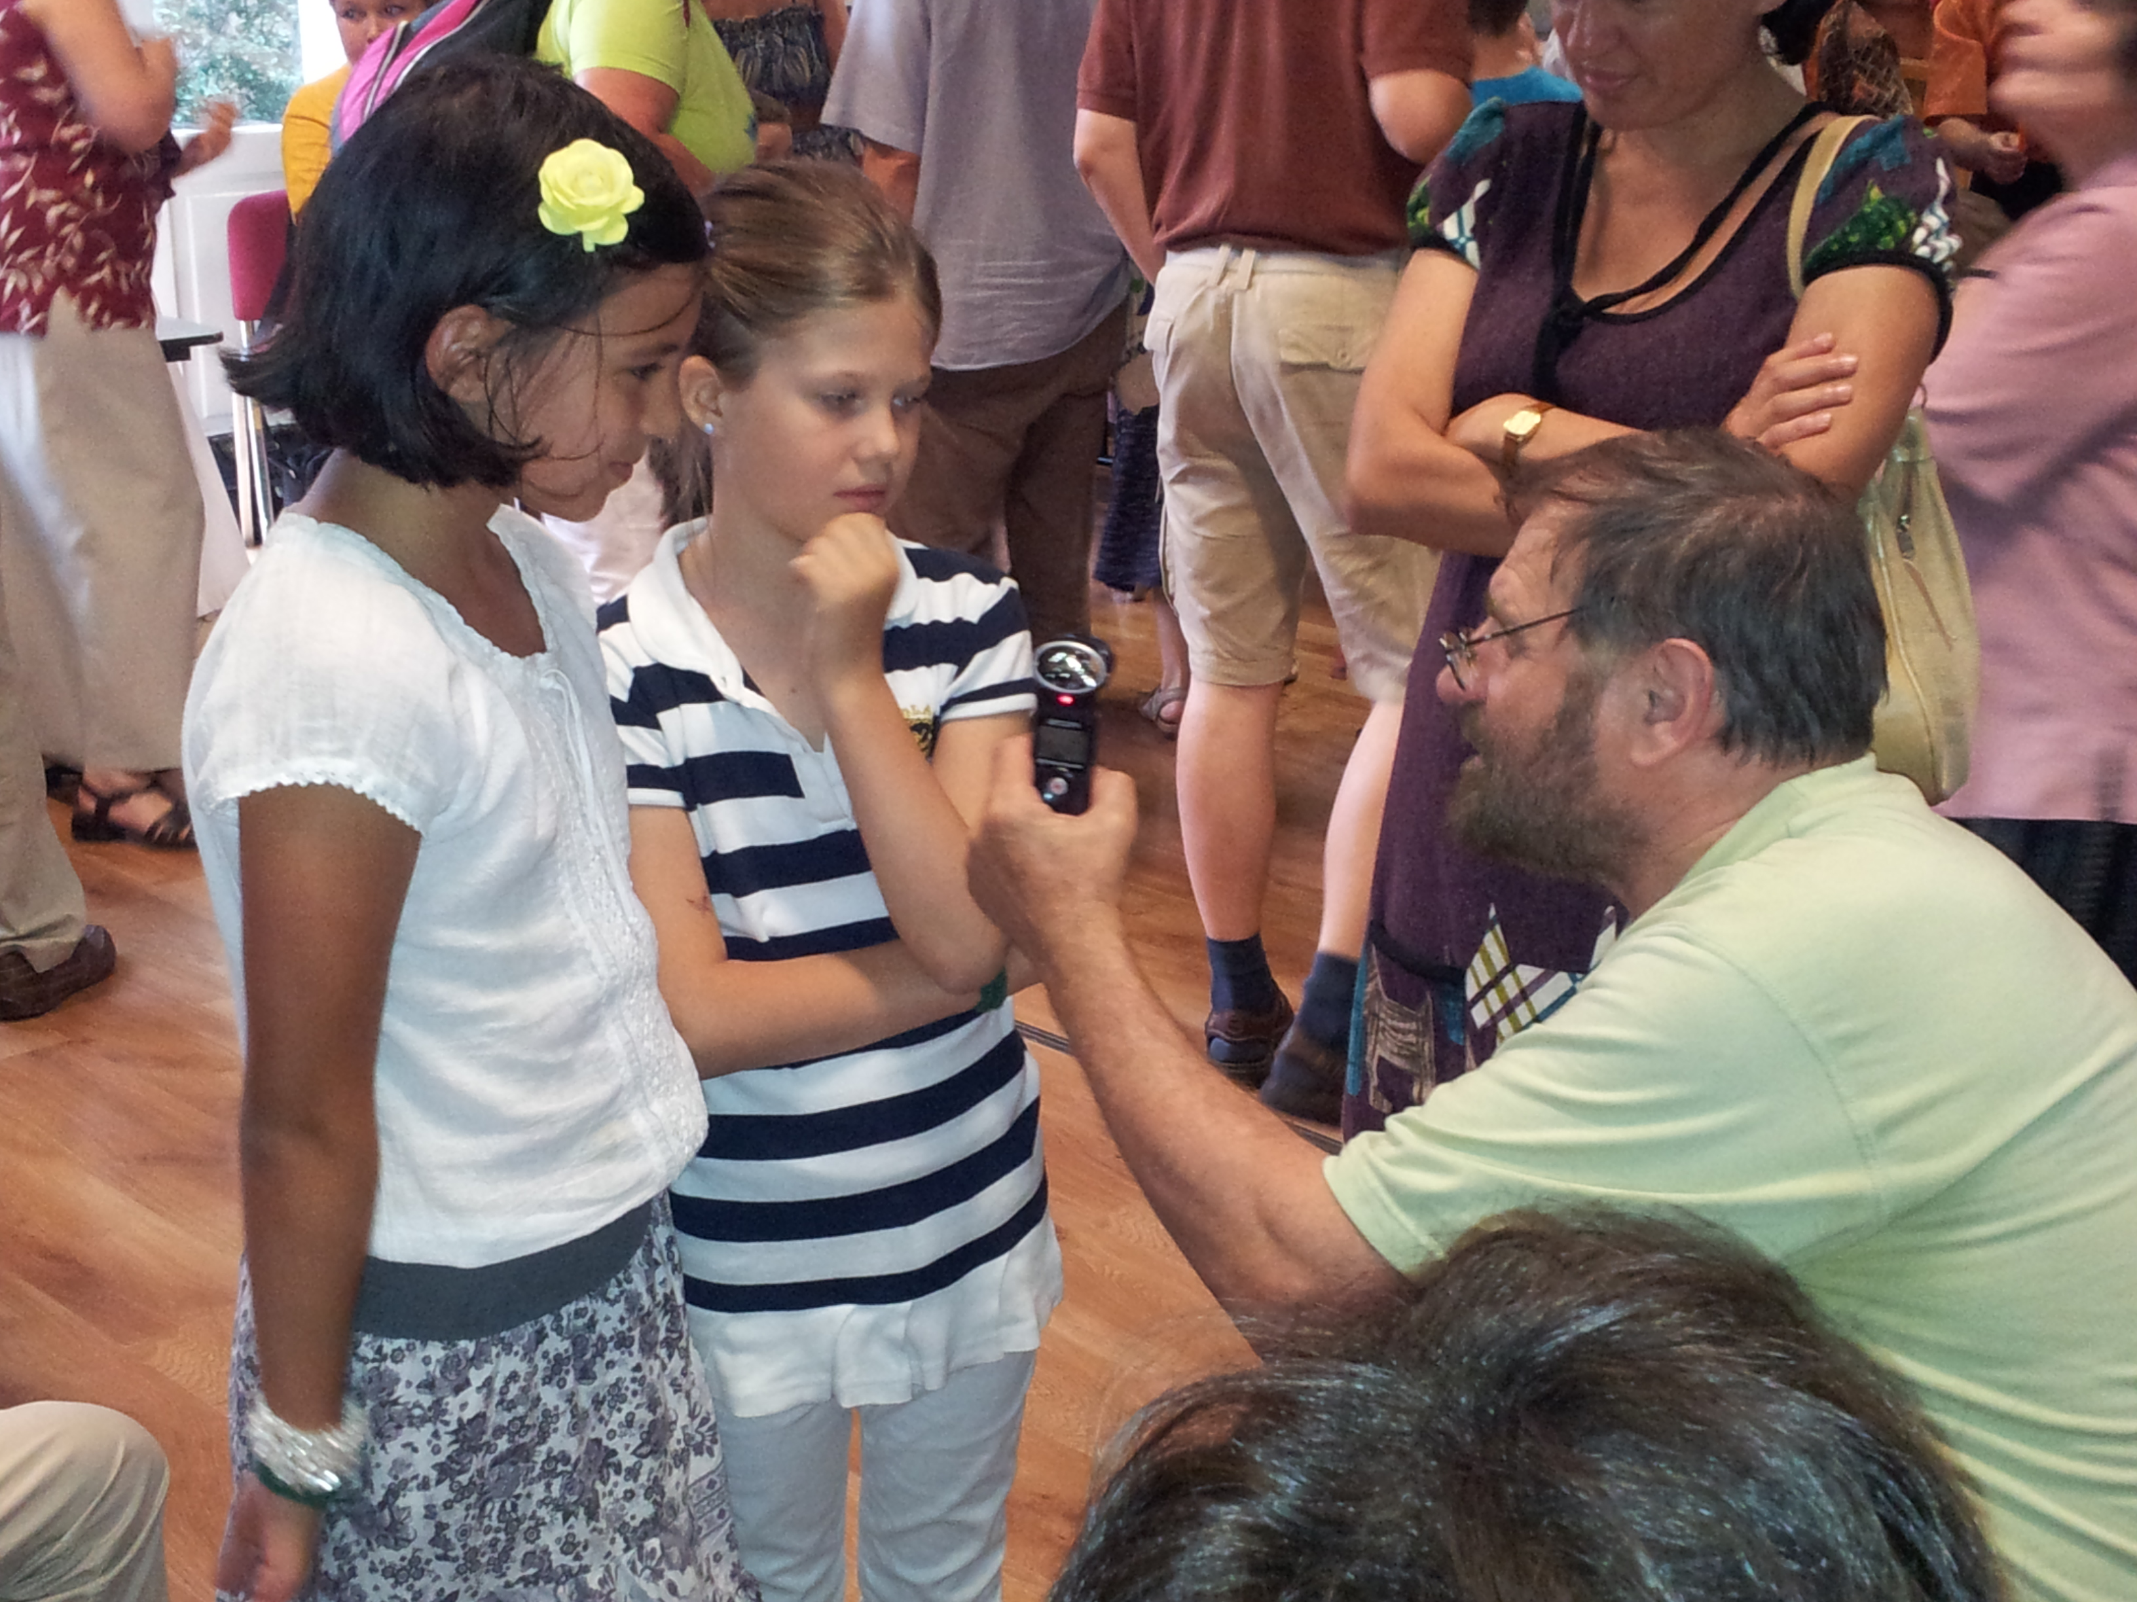
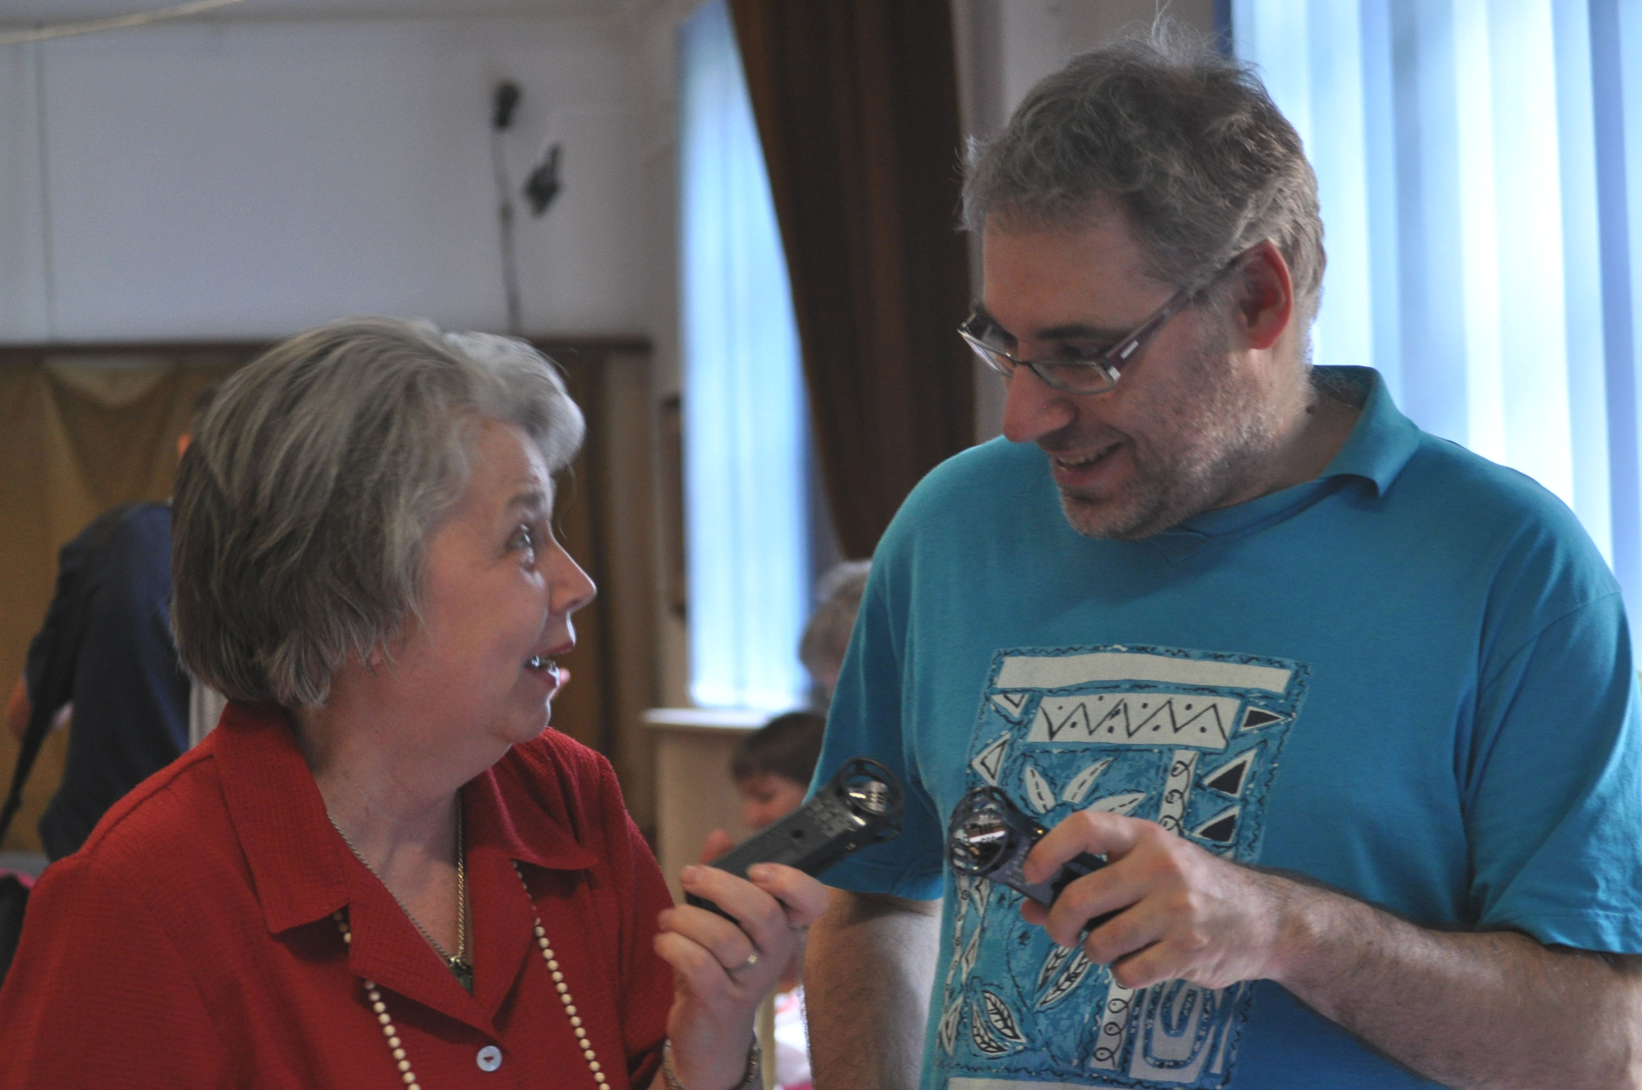
60+
Or how to involve elderly people into community media

Slide 2
How it started?
The beginning
Civil Radio is a local community radio with many local issues in the radio programs.
Local government initiated the media training of elderly people (2012 European year of active ageing and intergenerational solidarity)

Slide 3
The beginning – recruitment
How it started?
How did we recruit the elderly people?
Local forums / newspapers
What were their attitudes/preconceptions towards (community) media
Public media patterns
What were/are their purposes of being involved in a radio team?
Creative occupation, responsibility, team / community work

Slide 4
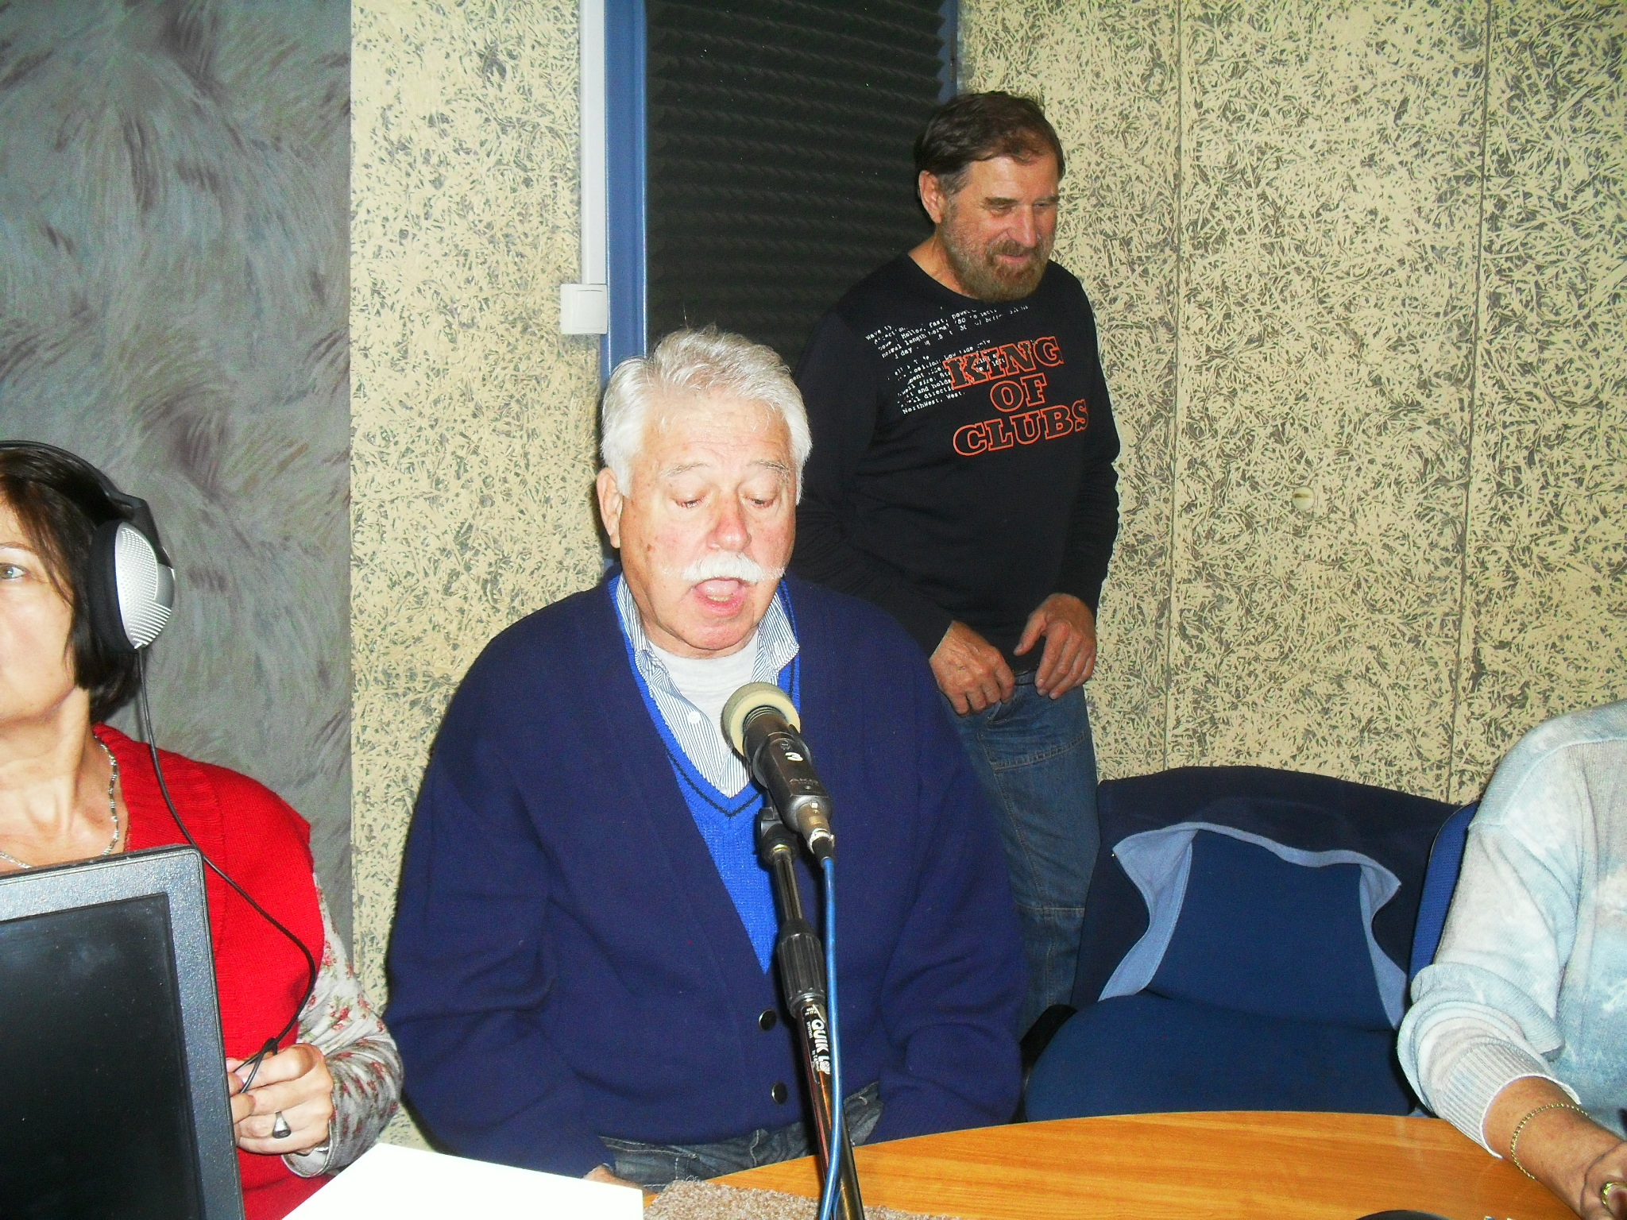
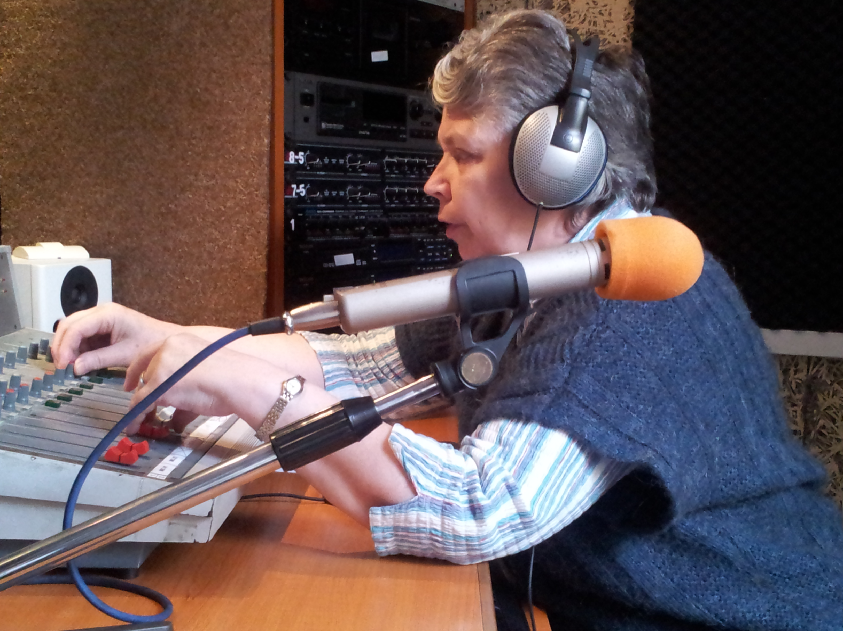
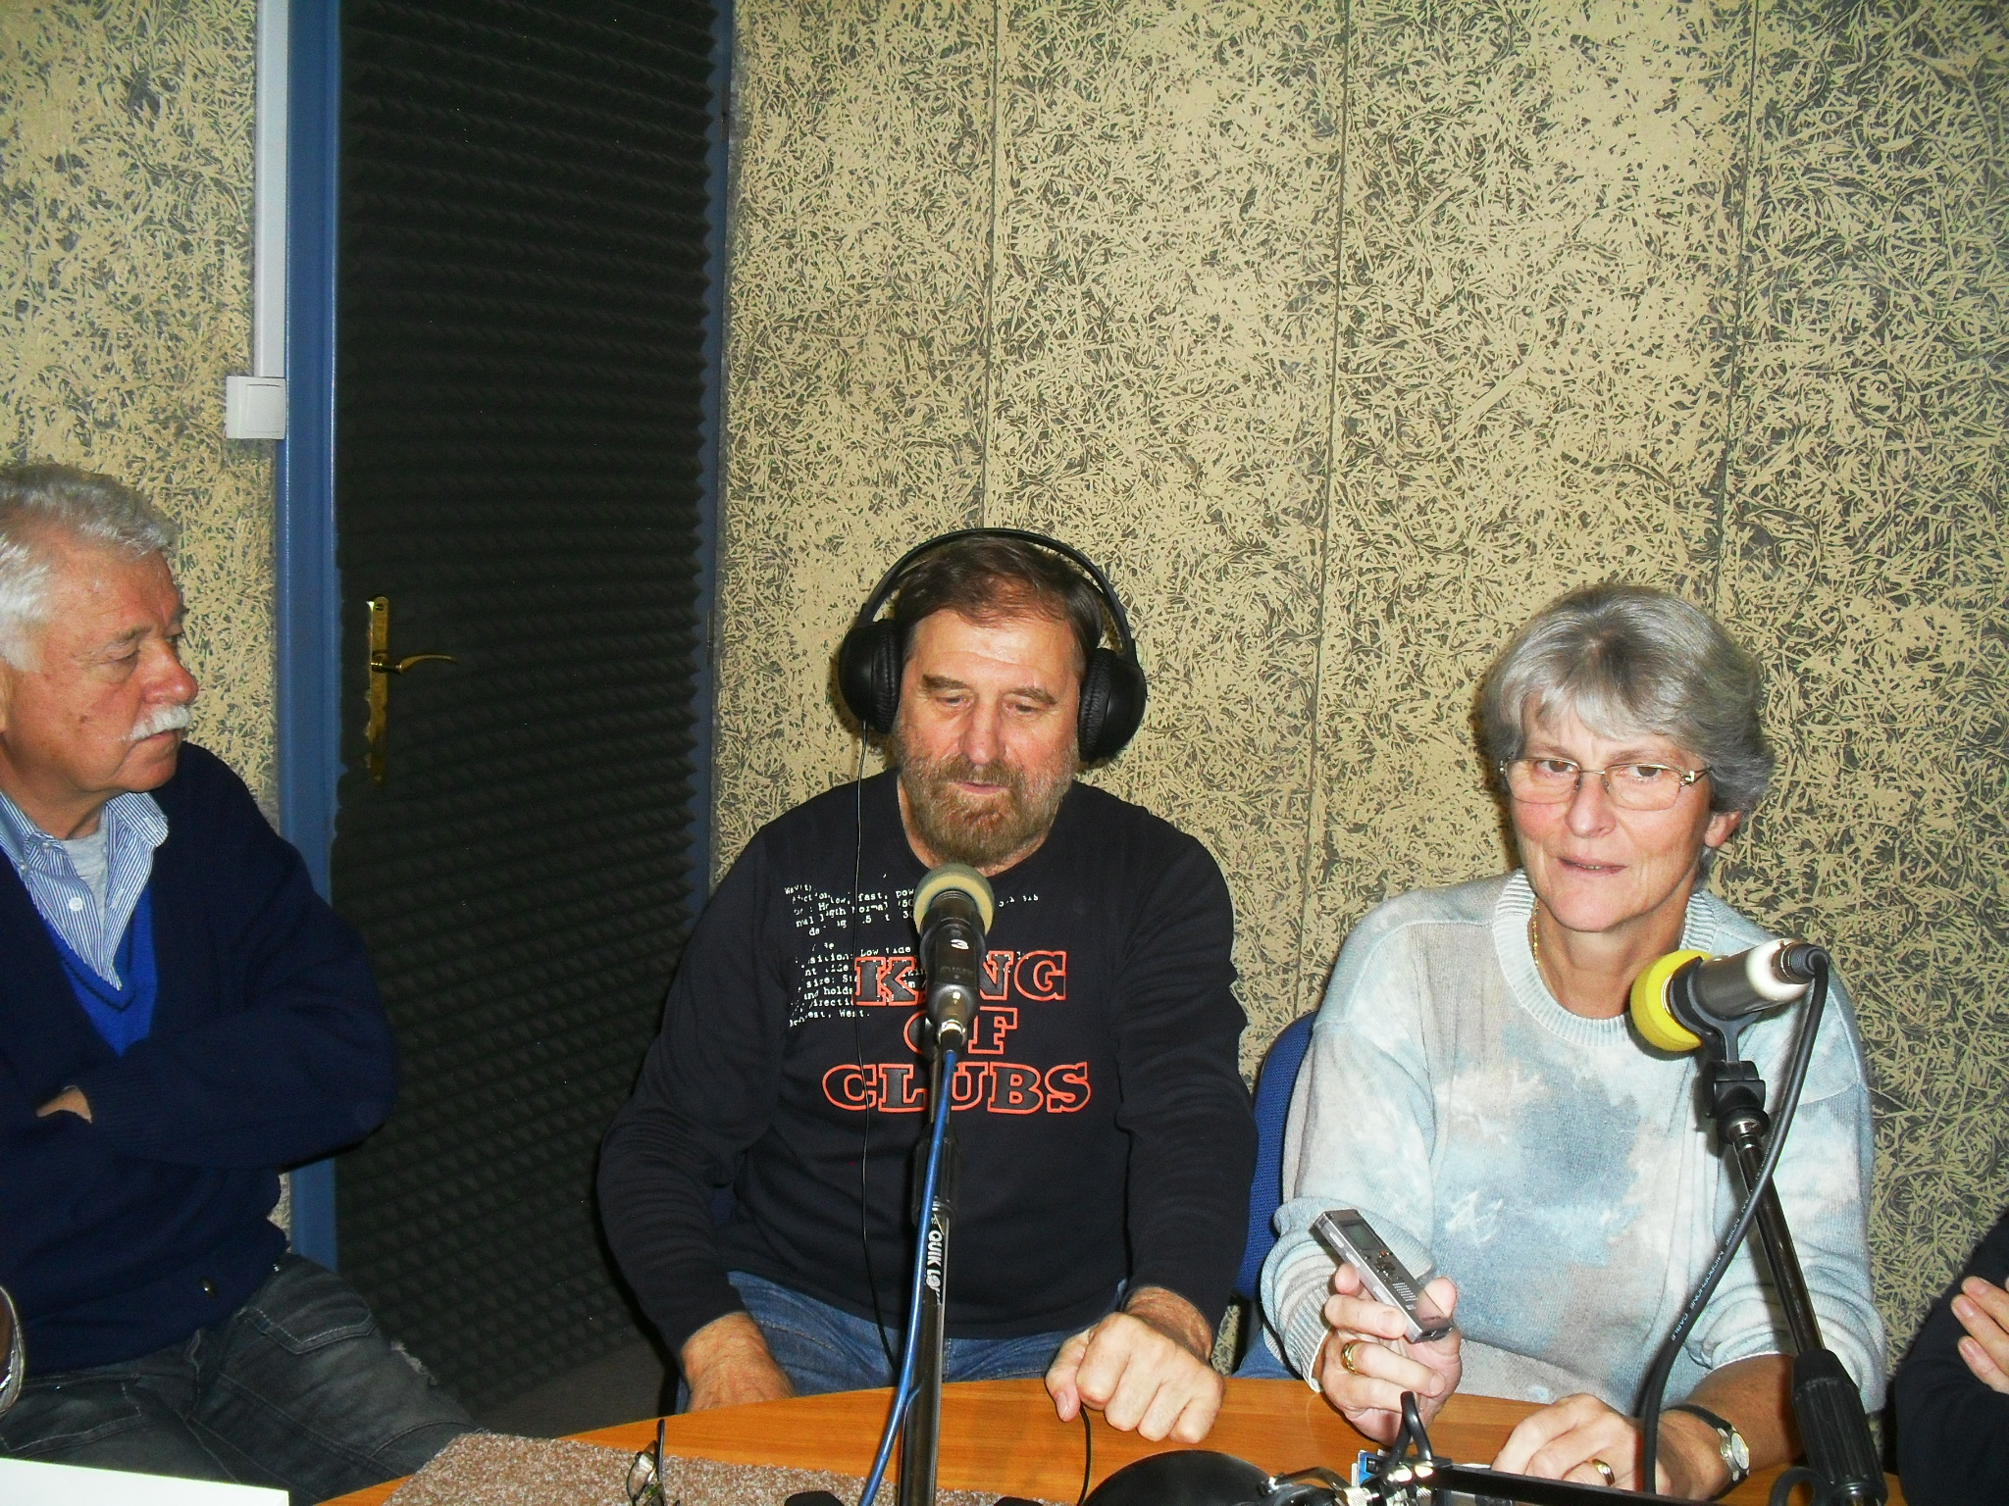
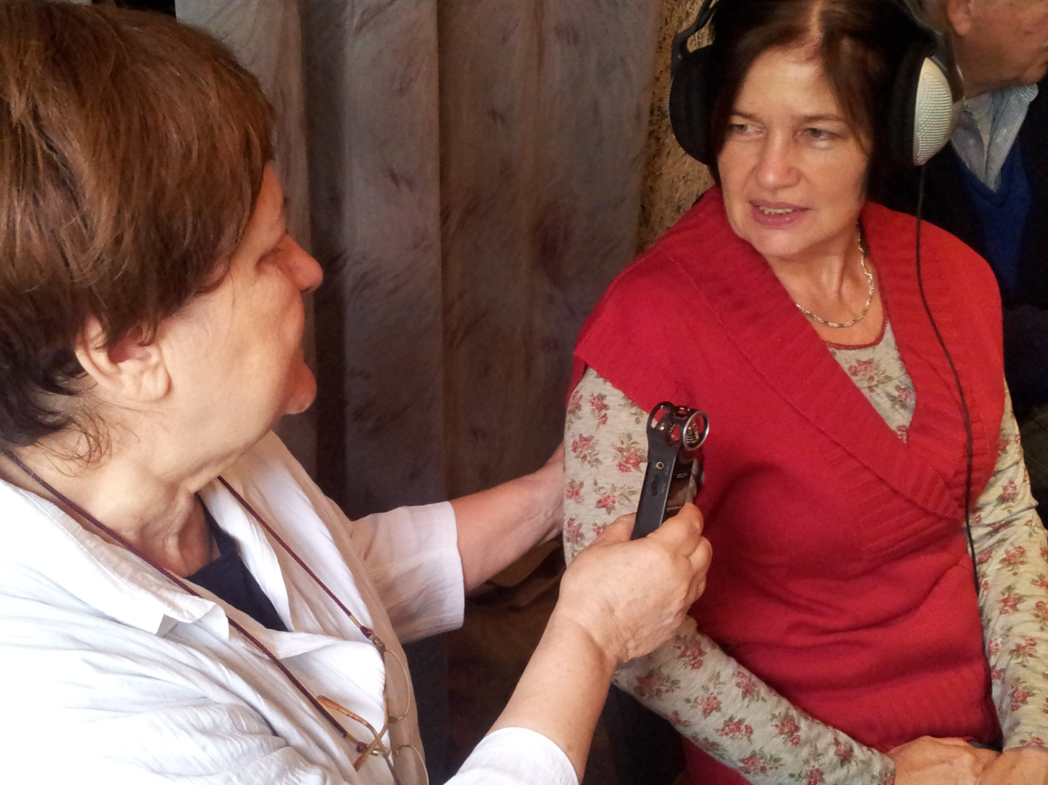
The training
How do we train elderly people?

Slide 5
The training
Basic structure of the course
2 days long trainings
1st day – communication / media /journalistic skills
Holistic methods – student-centered – exercise-centered
2nd day – technical training

Slide 6
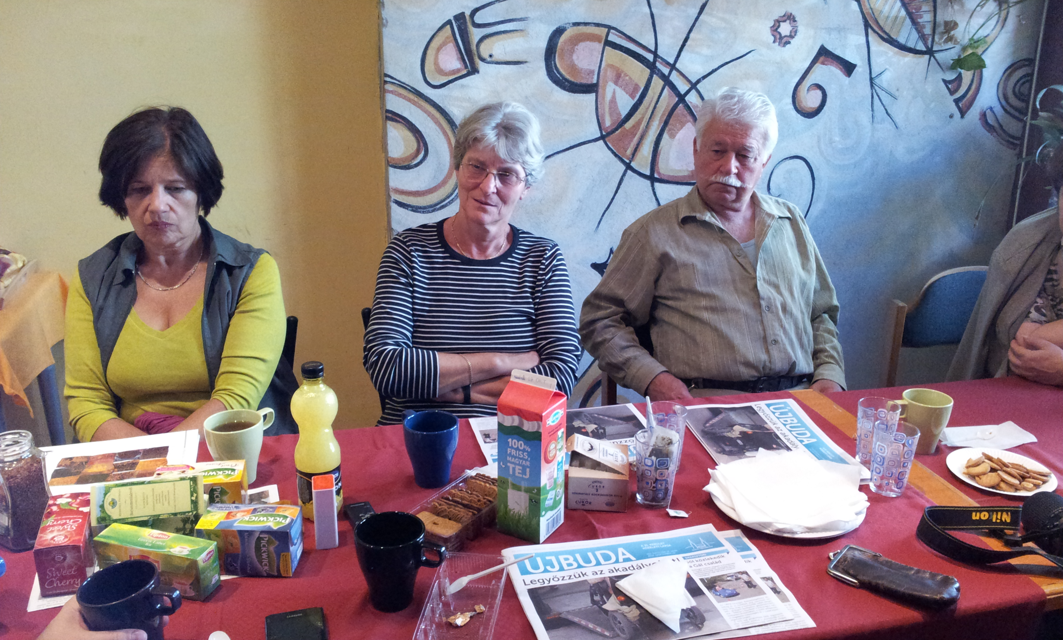
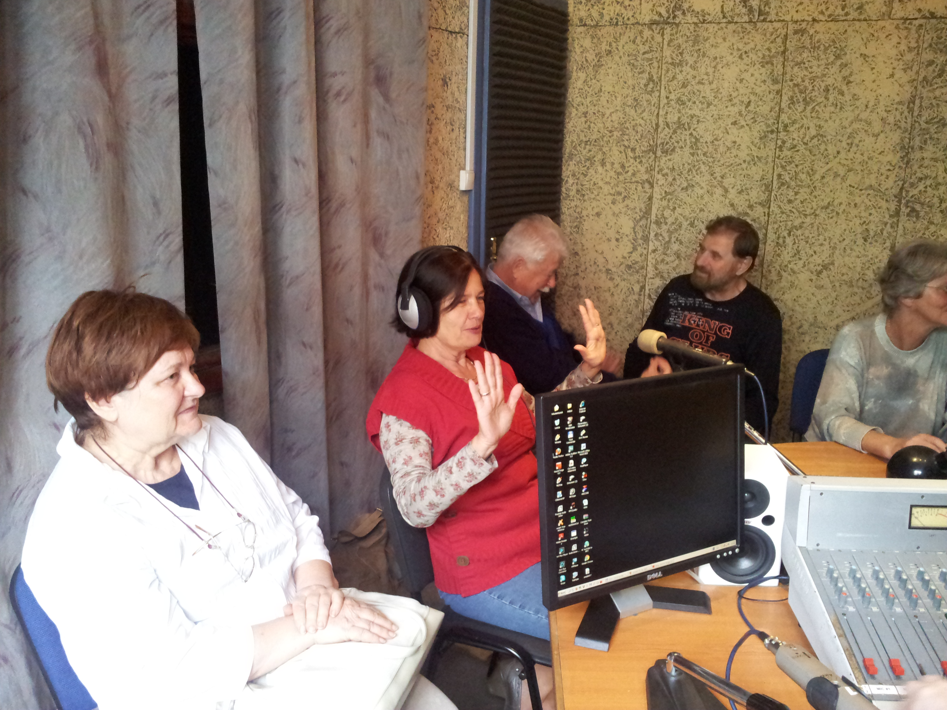
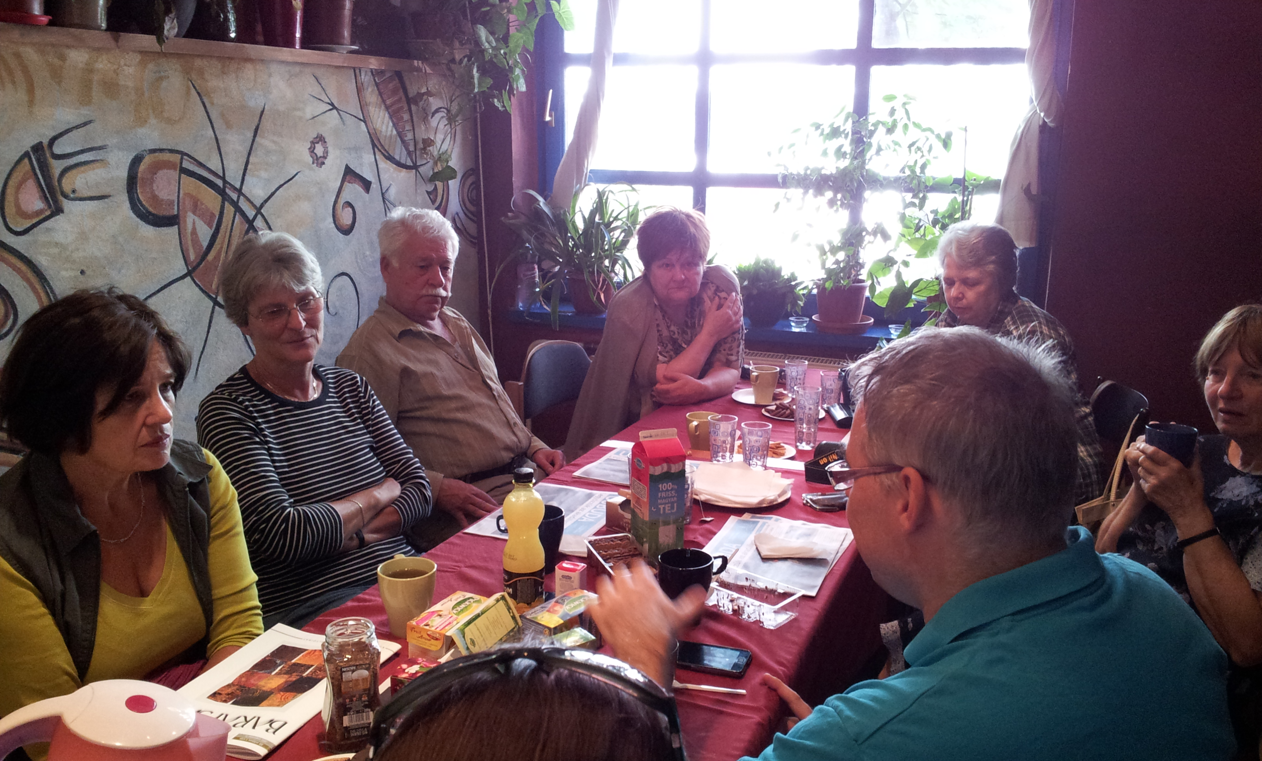
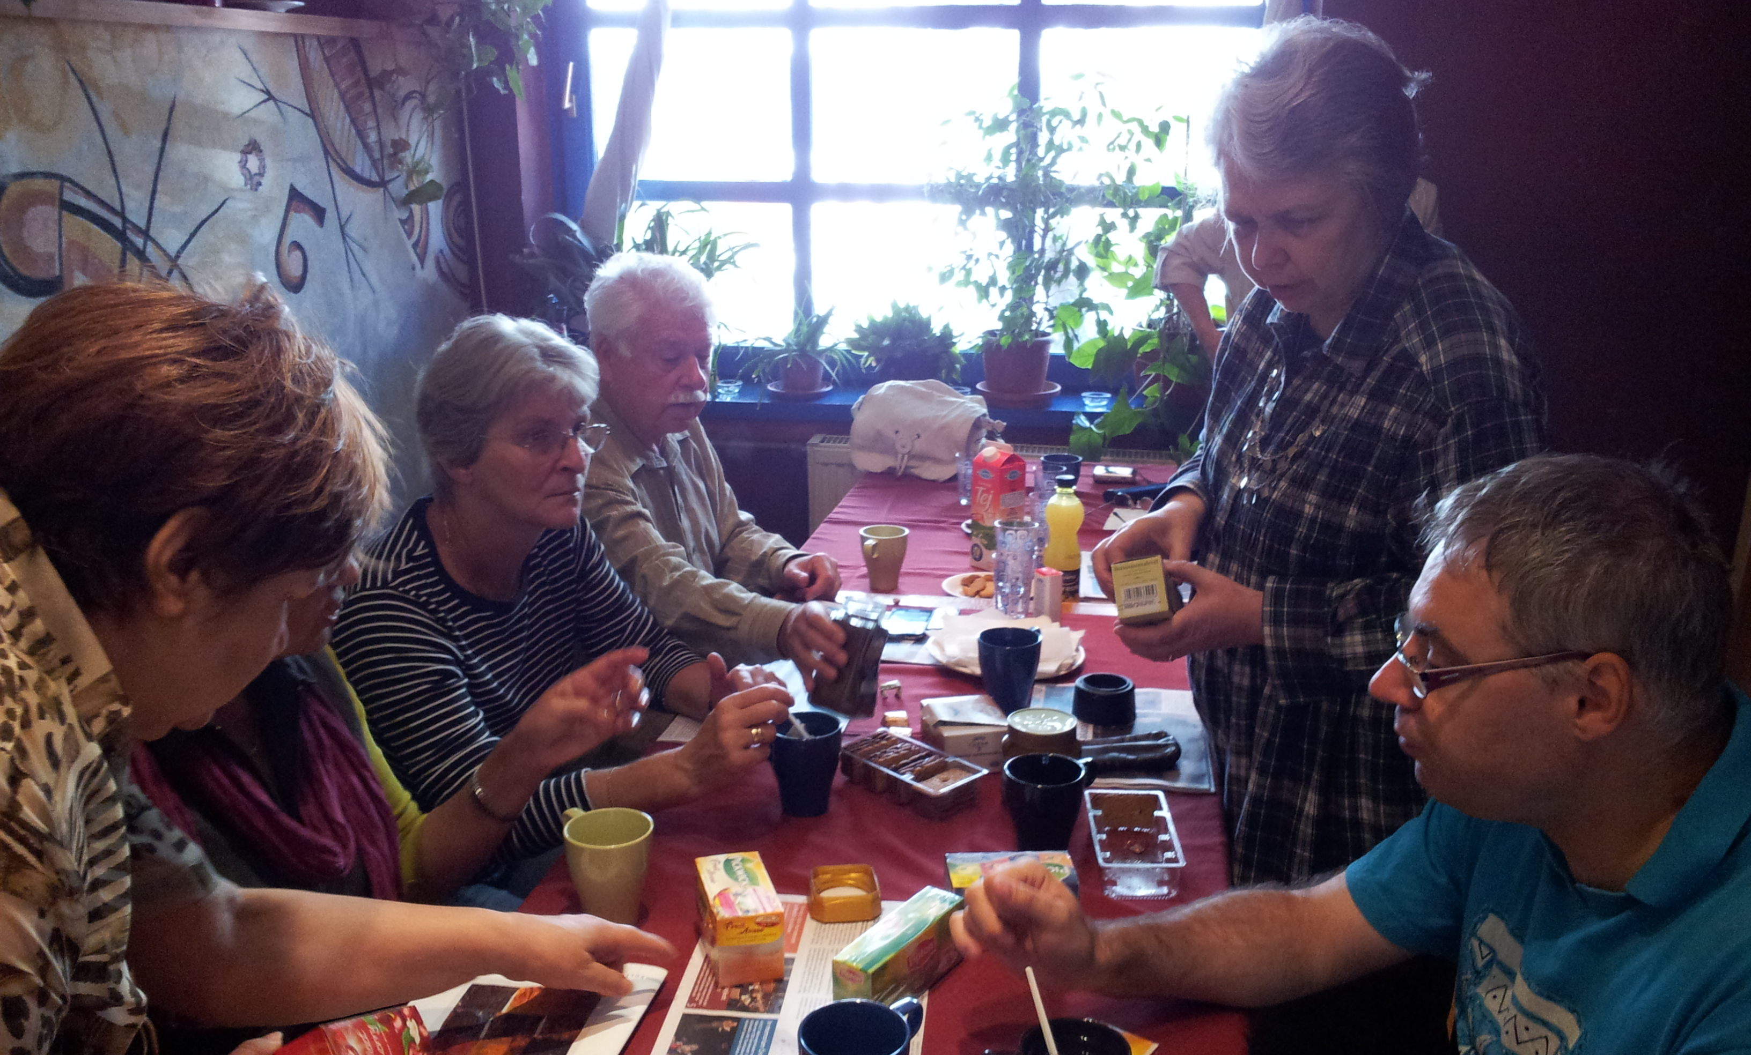
Specialties and challenges of training elderly people
BALANCE AND FLEXIBILITY
Elderly people are more impatient, less tolerable, more experienced in life in general
The trainer is usually younger – cannot act as an authority
Usual “training patterns” do not work
Trainer must be very sensitive to group dynamics – more tolerant, empathetic and patient

